Slide 1

Deep Learning 1
2025-2026 – Pascal Mettes
Lecture 1
Introduction and history of deep learning

Slide 2
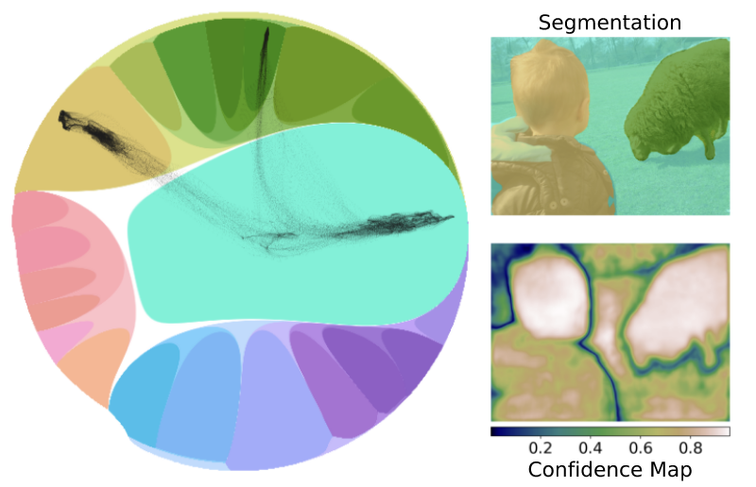
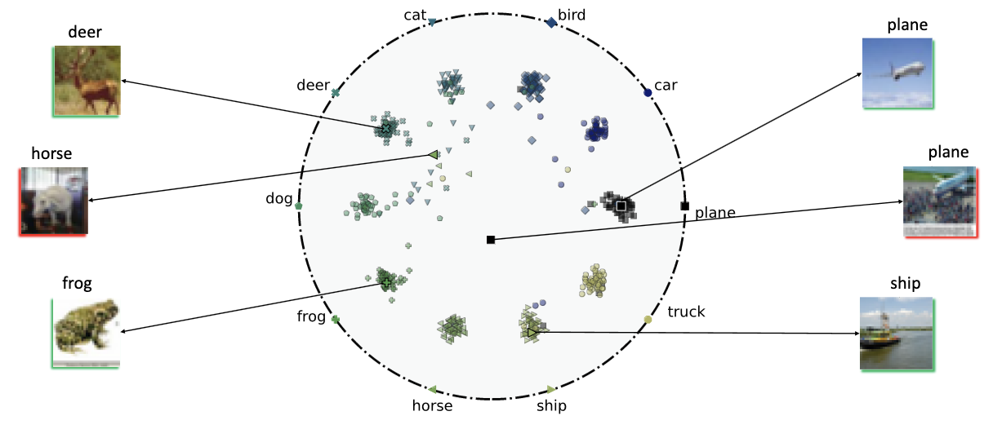
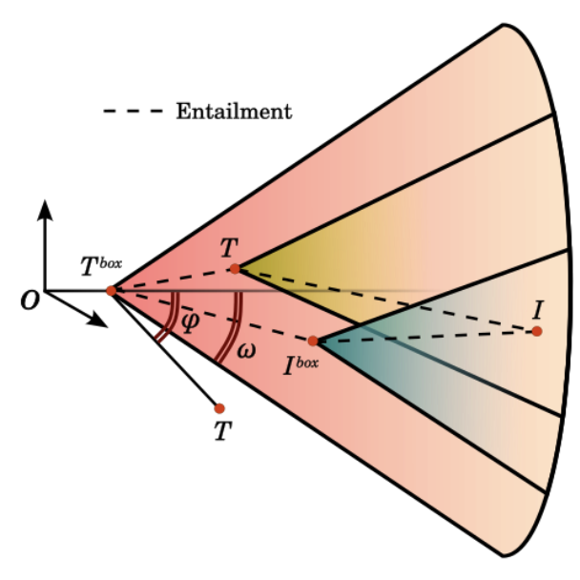
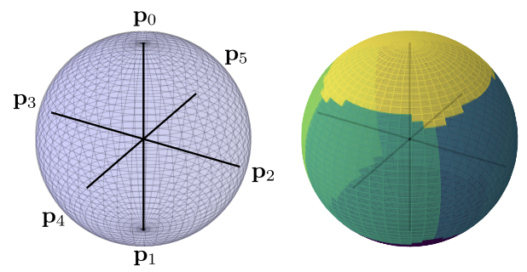
A warm welcome from me
About me
Assistant Professor at University of Amsterdam
PI of HypLab (Hyperbolic Deep Learning Lab)
Scientific manager of HAVA Lab (Human Aligned Video AI Lab)
Our research mission
We question the geometric foundation of
deep learning and we are leading a new
direction of deep learning in hyperbolic space.

Slide 3
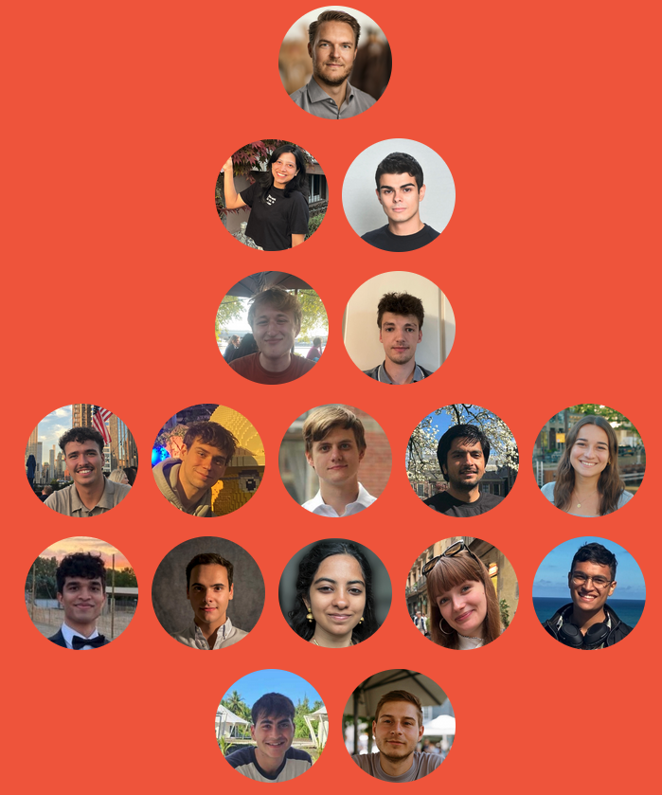
A warm welcome from our team

Slide 4
What is the course about?
Lecture | Title
1 | Intro and history of deep learning
3 | Deep learning optimization I
5 | Convolutional deep learning
7 | Graph deep learning
9 | Multi-modal deep learning
11 | What doesn’t work in deep learning
13 | Q&A
Lecture | Title
2 | AutoDiff
4 | Deep learning optimization II
6 | Attention-based deep learning
8 | From supervised to unsupervised deep learning
10 | Generative deep learning
12 | Non-Euclidean deep learning
14 | Deep learning for videos

Slide 5
My goals with this course
Provide an intuitive foundation for understanding deep learning.
Challenge you to dive into the topic and learning by interacting and doing.
Give you the best starting point for following courses and the thesis.
Look at deep learning critically and understand what works and what doesn’t.

Slide 6
Prerequisites
Machine Learning 1
Calculus and Linear Algebra
Derivatives, integrals
Matrix operations
Computing lower bounds, limits
Some Probability Theory and Statistics
Advanced programming

Slide 7
Reading materials
Textbooks (most available online)
Deep Learning by I. Goodfellow, Y. Bengio, A. Courville, 2016
Dive Into Deep Learning, by A. Zhang, Z. Lipton, M. Li, A. Smola, 2019
Neural Networks and Deep Learning: A Textbook, by C. Aggarwal, 2018
https://udlbook.github.io/udlbook/ Understanding Deep Learning S.J.D. Prince 2022
Papers mentioned in the slides
At the end of each lecture, I list book chapters and papers to read

Slide 8
Tutorials
Alongside the lectures and the practicals, we have prepared tutorials.
In the tutorials we go step by step through fundamental concepts.
The tutorials include code, visualizations and explanations.
https://uvadlc-notebooks.readthedocs.io/
Held Tuesdays at 11:00-13:00.
Serves as extra service to you, to bridge theory and implementation.
At each tutorial, there will be some pen and paper questions: exam pre-practice.

Slide 9
Tutorial list
1: Intro to Snellius (!!!) and PyTorch
2: Activation functions + Tutorial 4: Optimization and Initialization
3: Inception, ResNet and DenseNet
4: Transformers and Multi-Head Attention
5: Graph Neural Networks
6: Self-Supervised Contrastive Learning with SimCLR
7: TBD

Slide 10
Exam and grading
Two parts: practicals (30%) + exam (70%).
Practicals grade = average grade of the three assignments.
Exam is classical written in-person assignment.

Slide 11
Practicals
Practical 1 [deadline: 9-11-2025]
Implement your own net modules, learn about core modules of deep learning.
Practical 2 [deadline: 30-11-2025]
Invariances in ConvNets, build your own nano-GPT, graph network theory.
Practical 3 [deadline: 14-12-2025]
Break networks with adversarial attacks and generative learning.

Slide 12
Vision of the practicals
Consists of both theory and implementation questions, handled through ANS.
Complementary view and information stream to the lectures.
Both a hands-on view to the lectures and its own reading materials!
On purpose with a view different interpretation and more theoretical background.

Slide 13
Snellius
We have secured a healthy amount of computation units for Deep Learning 1.
Tutorial 1 will cover the essentials of Snellius.
Lab 1 will also partially cover doing AI on clusters.

Slide 14
On grades
6
10
8

Slide 15
On boredom

Slide 16
Plagiarism (standard slide)
Plagiarism will not be tolerated
Academic discussions are encouraged, and you can help each other
What is plagiarism? Copying from each other is plagiarism. Sharing is plagiarism. Seeing someone else’s code and retyping is plagiarism. Copying ideas & structure. Copying from existing GitHub accounts is plagiarism. Of course, re-using past answers is plagiarism. You devalue your own diploma, you make no good use of your money, and you take time we spend from teaching and reporting to do something we don’t enjoy
Previously suspected cases
Most got assignment nullified, some lost this/next year exam opportunities
We check answer sheets from previous years, existing GitHubs and code repos, each other’s answer sheets and other resources (we also use plagiarism-detection software)
Please, don’t!
Contact examiw-science@uva.nl for questions

Slide 17
Asking questions
During and after lectures, tutorials, and especially labs.
On Canvas Ed Discussions.
In case of technical/grade issues: contact Alejandro.
In case of personal/ethical/large-scale issues: contact me.

Slide 18
About Ed Discussions
Learning involves not understanding.
Asking questions is key to understanding.
Use Ed discussions to ask AND answer each other’s questions.
Multiples TAs will also check the platform regularly to answer questions.

Slide 19
Deep learning is an engineering science
This means:
We do not have fundamental & general theories for lots of areas.
Plenty of hands-on experience will lead to better development of intuition.
The field moves quickly.
Here we teach fundamentals, but some will be outdated very soon.
Therefore, another goal of this course: develop tools/skillset to be able to independently delve into new topics.
Developing intuition is more important than memorizing.

Slide 20
What is deep learning?

Slide 21
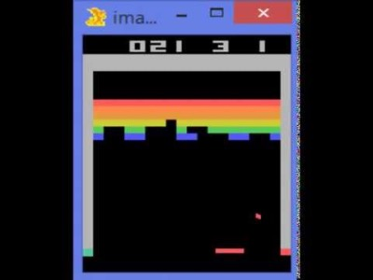
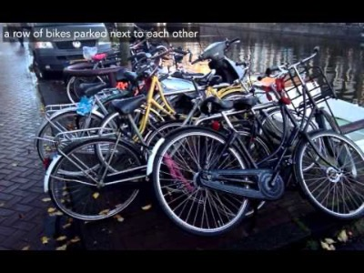
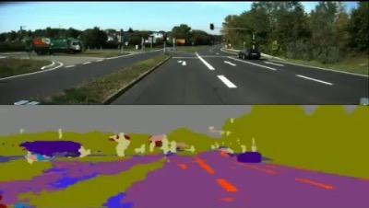
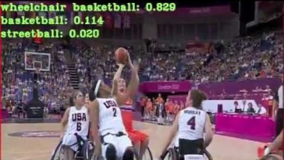
Highlights from first DL1 iteration (2016)
Playing Atari with Deep Reinforcement Learning. Mnih et al. 2013
SegNet: A Deep Convolutional Encoder-Decoder Architecture for Image Segmentation. Badrinarayanan et al. 2015
Large-scale Video Classification with Convolutional Neural Networks. Karpathy et al. 2014
https://github.com/karpathy/neuraltalk 2014

Slide 22
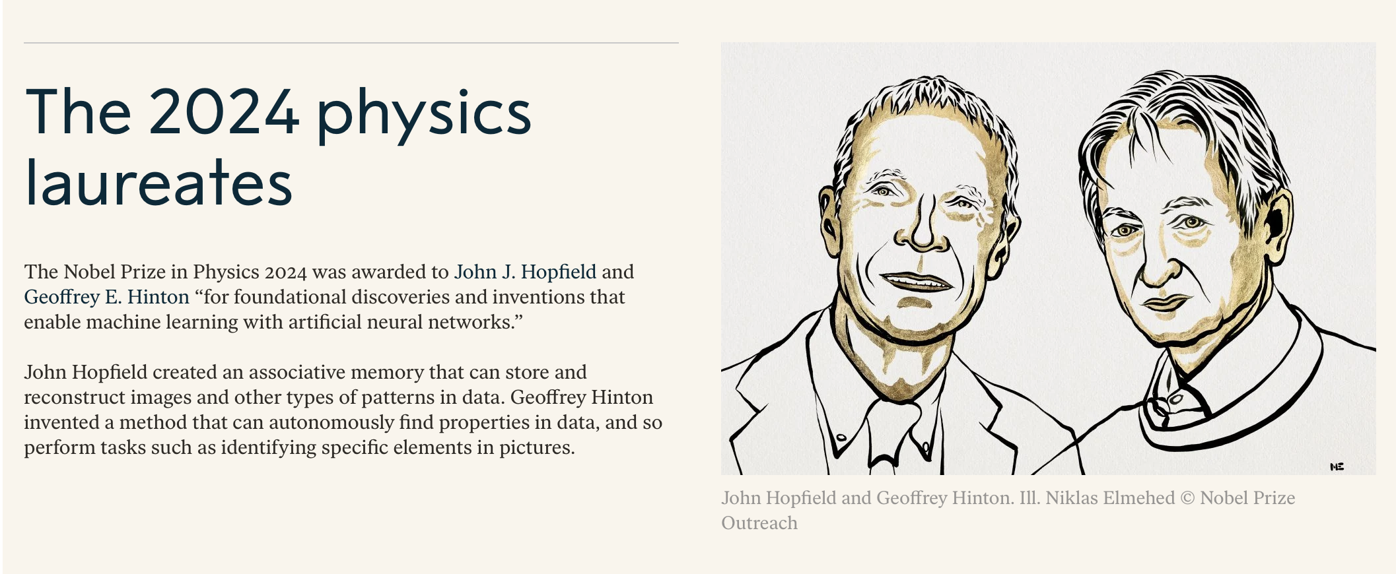
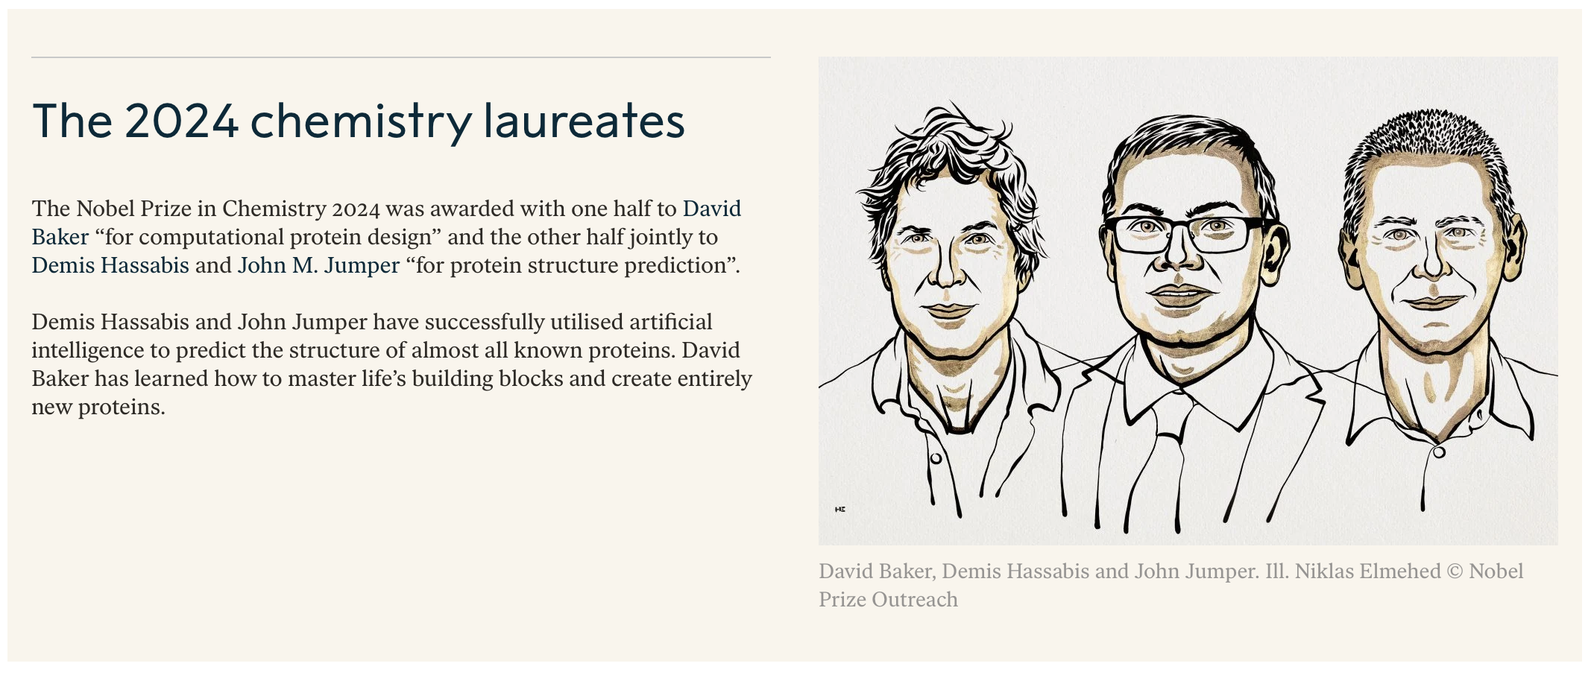

Slide 23
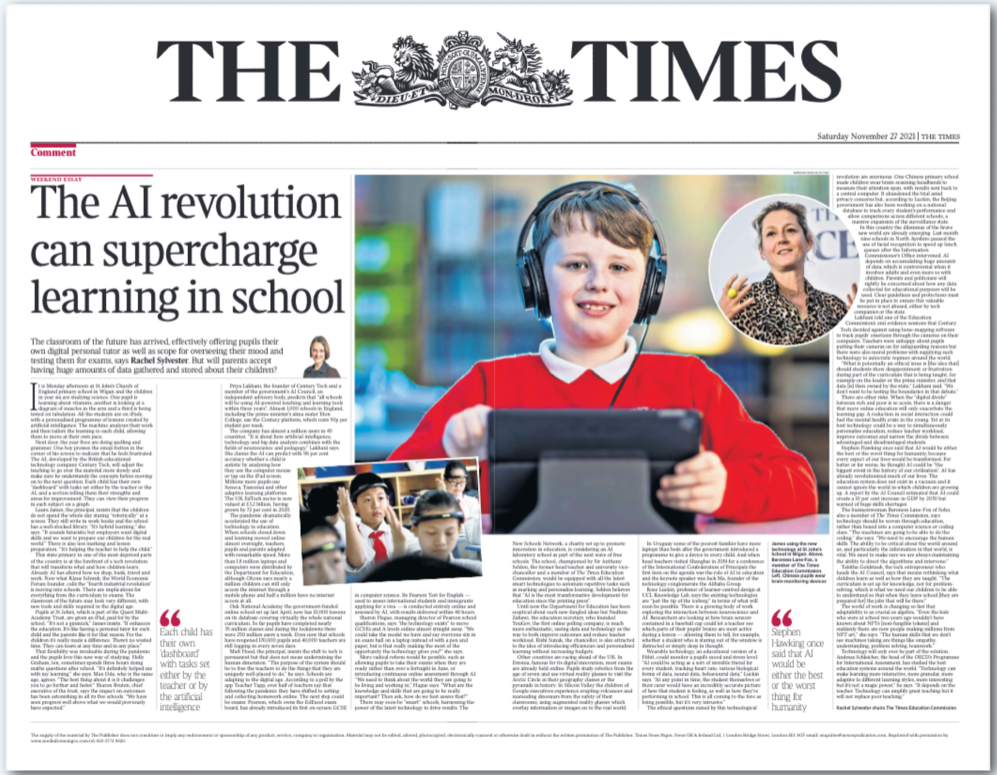
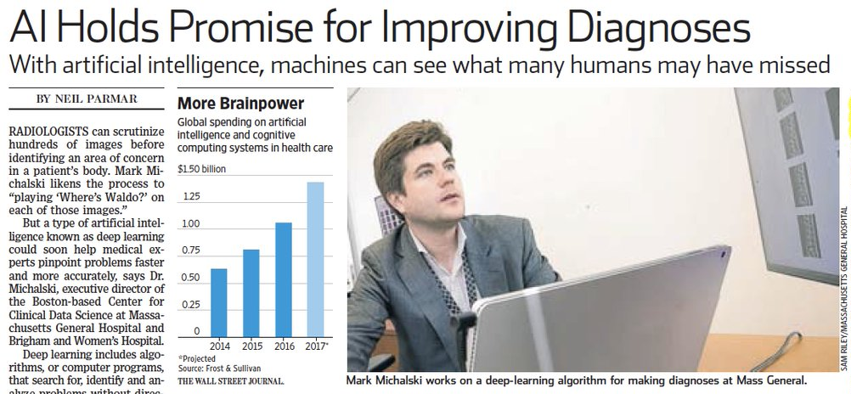
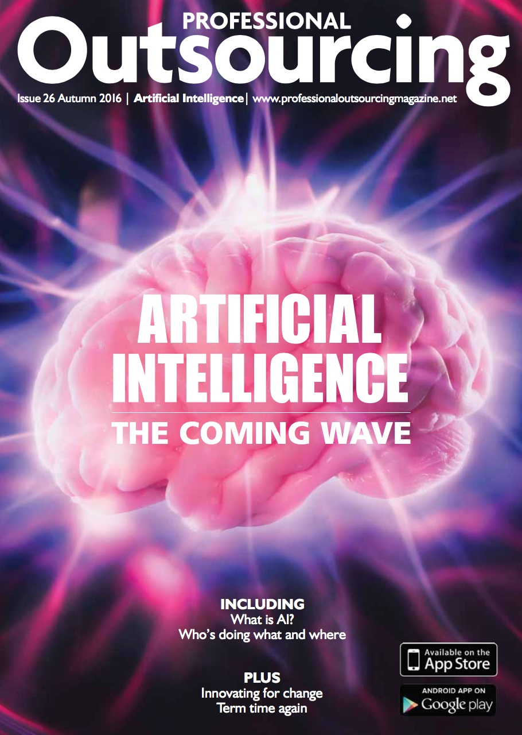
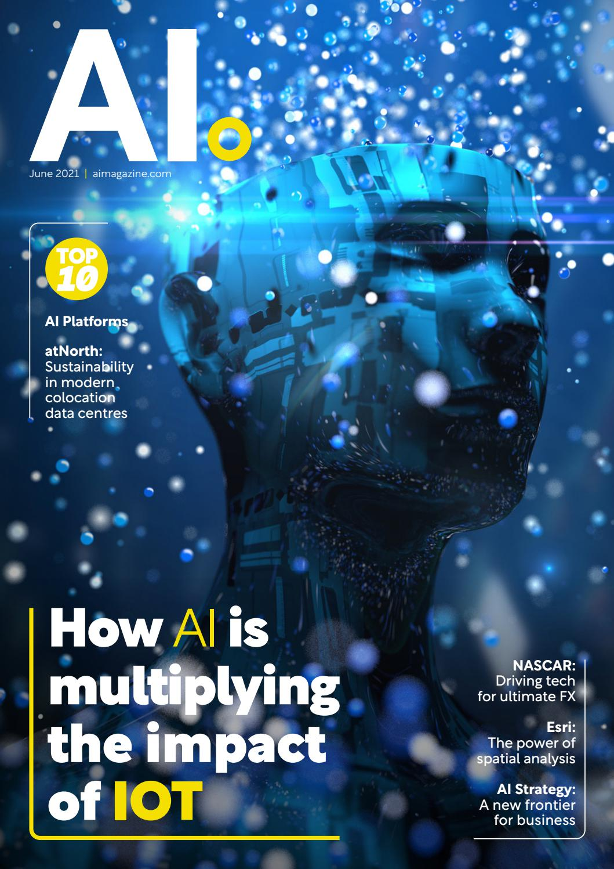
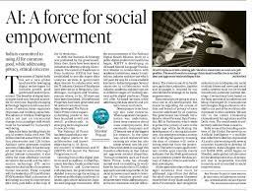

Slide 24
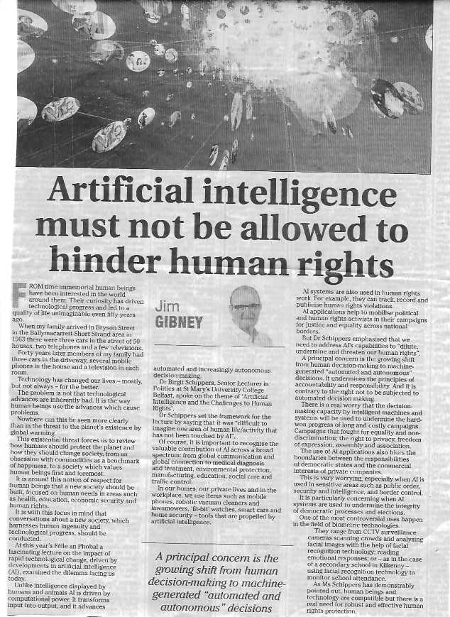
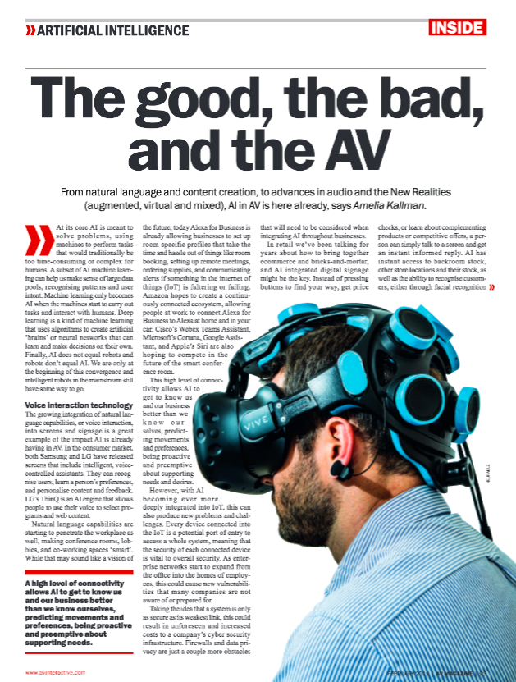
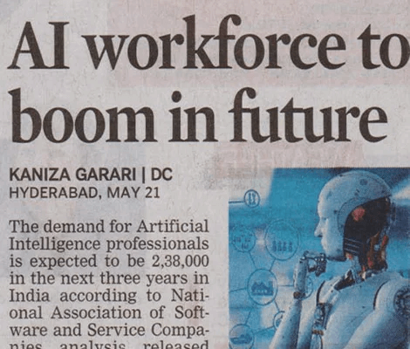

Slide 25
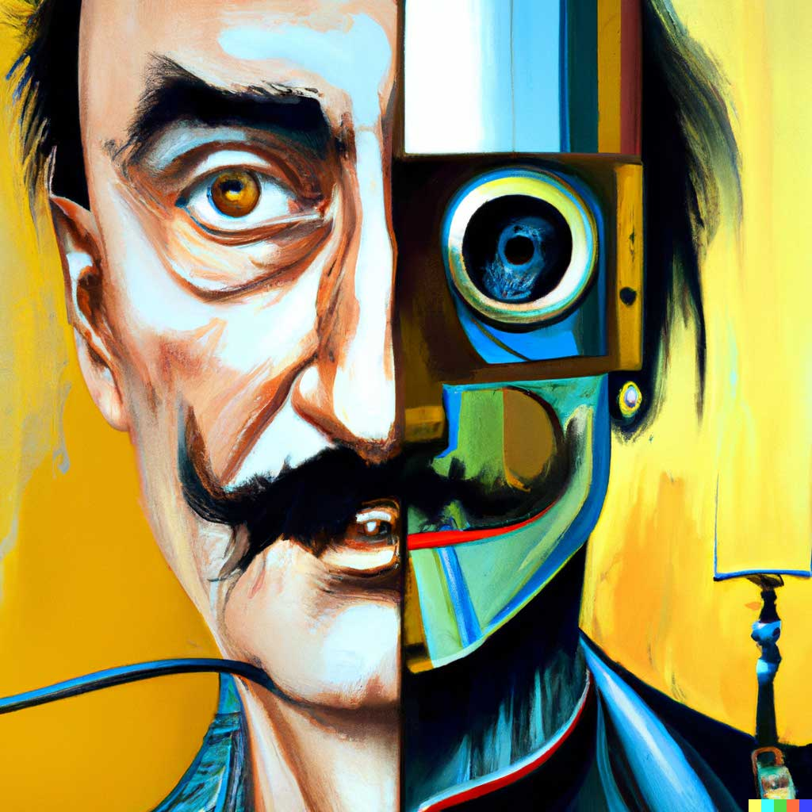
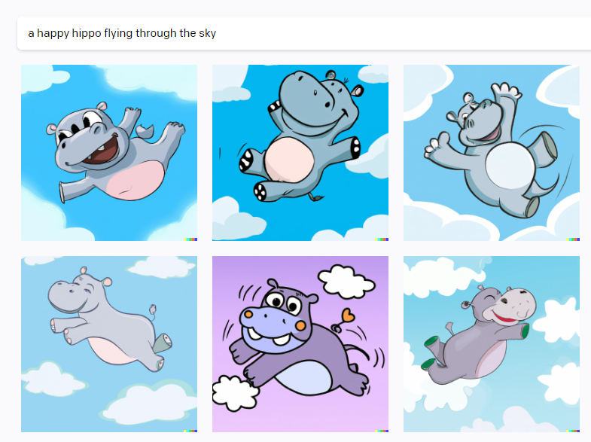
DALL-E 2

Slide 26
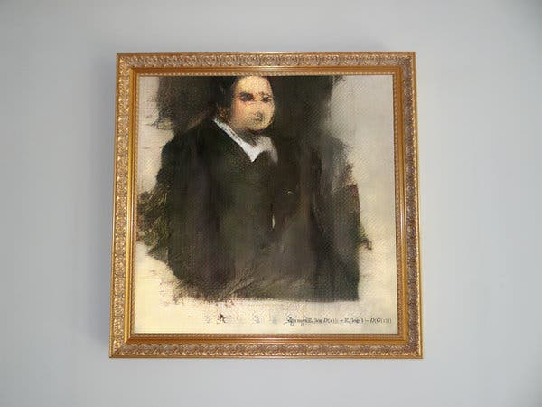

Slide 27
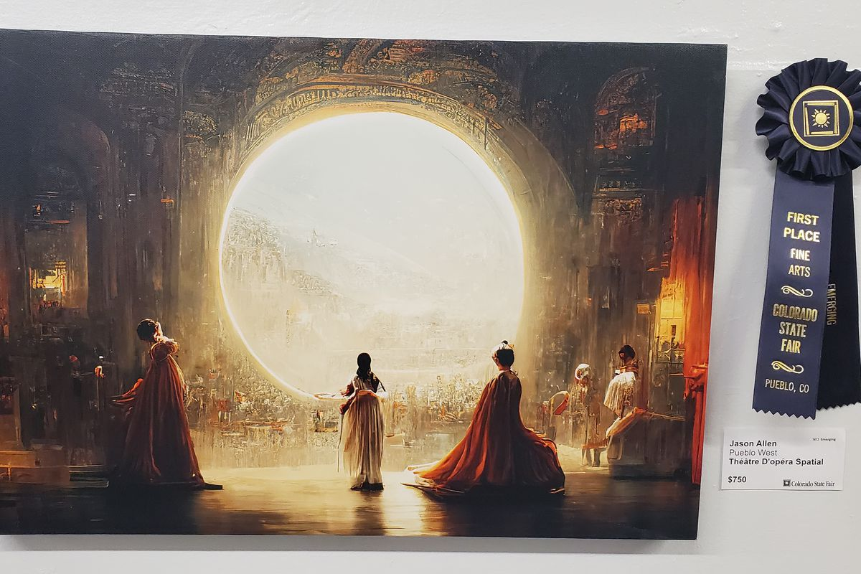

Slide 28
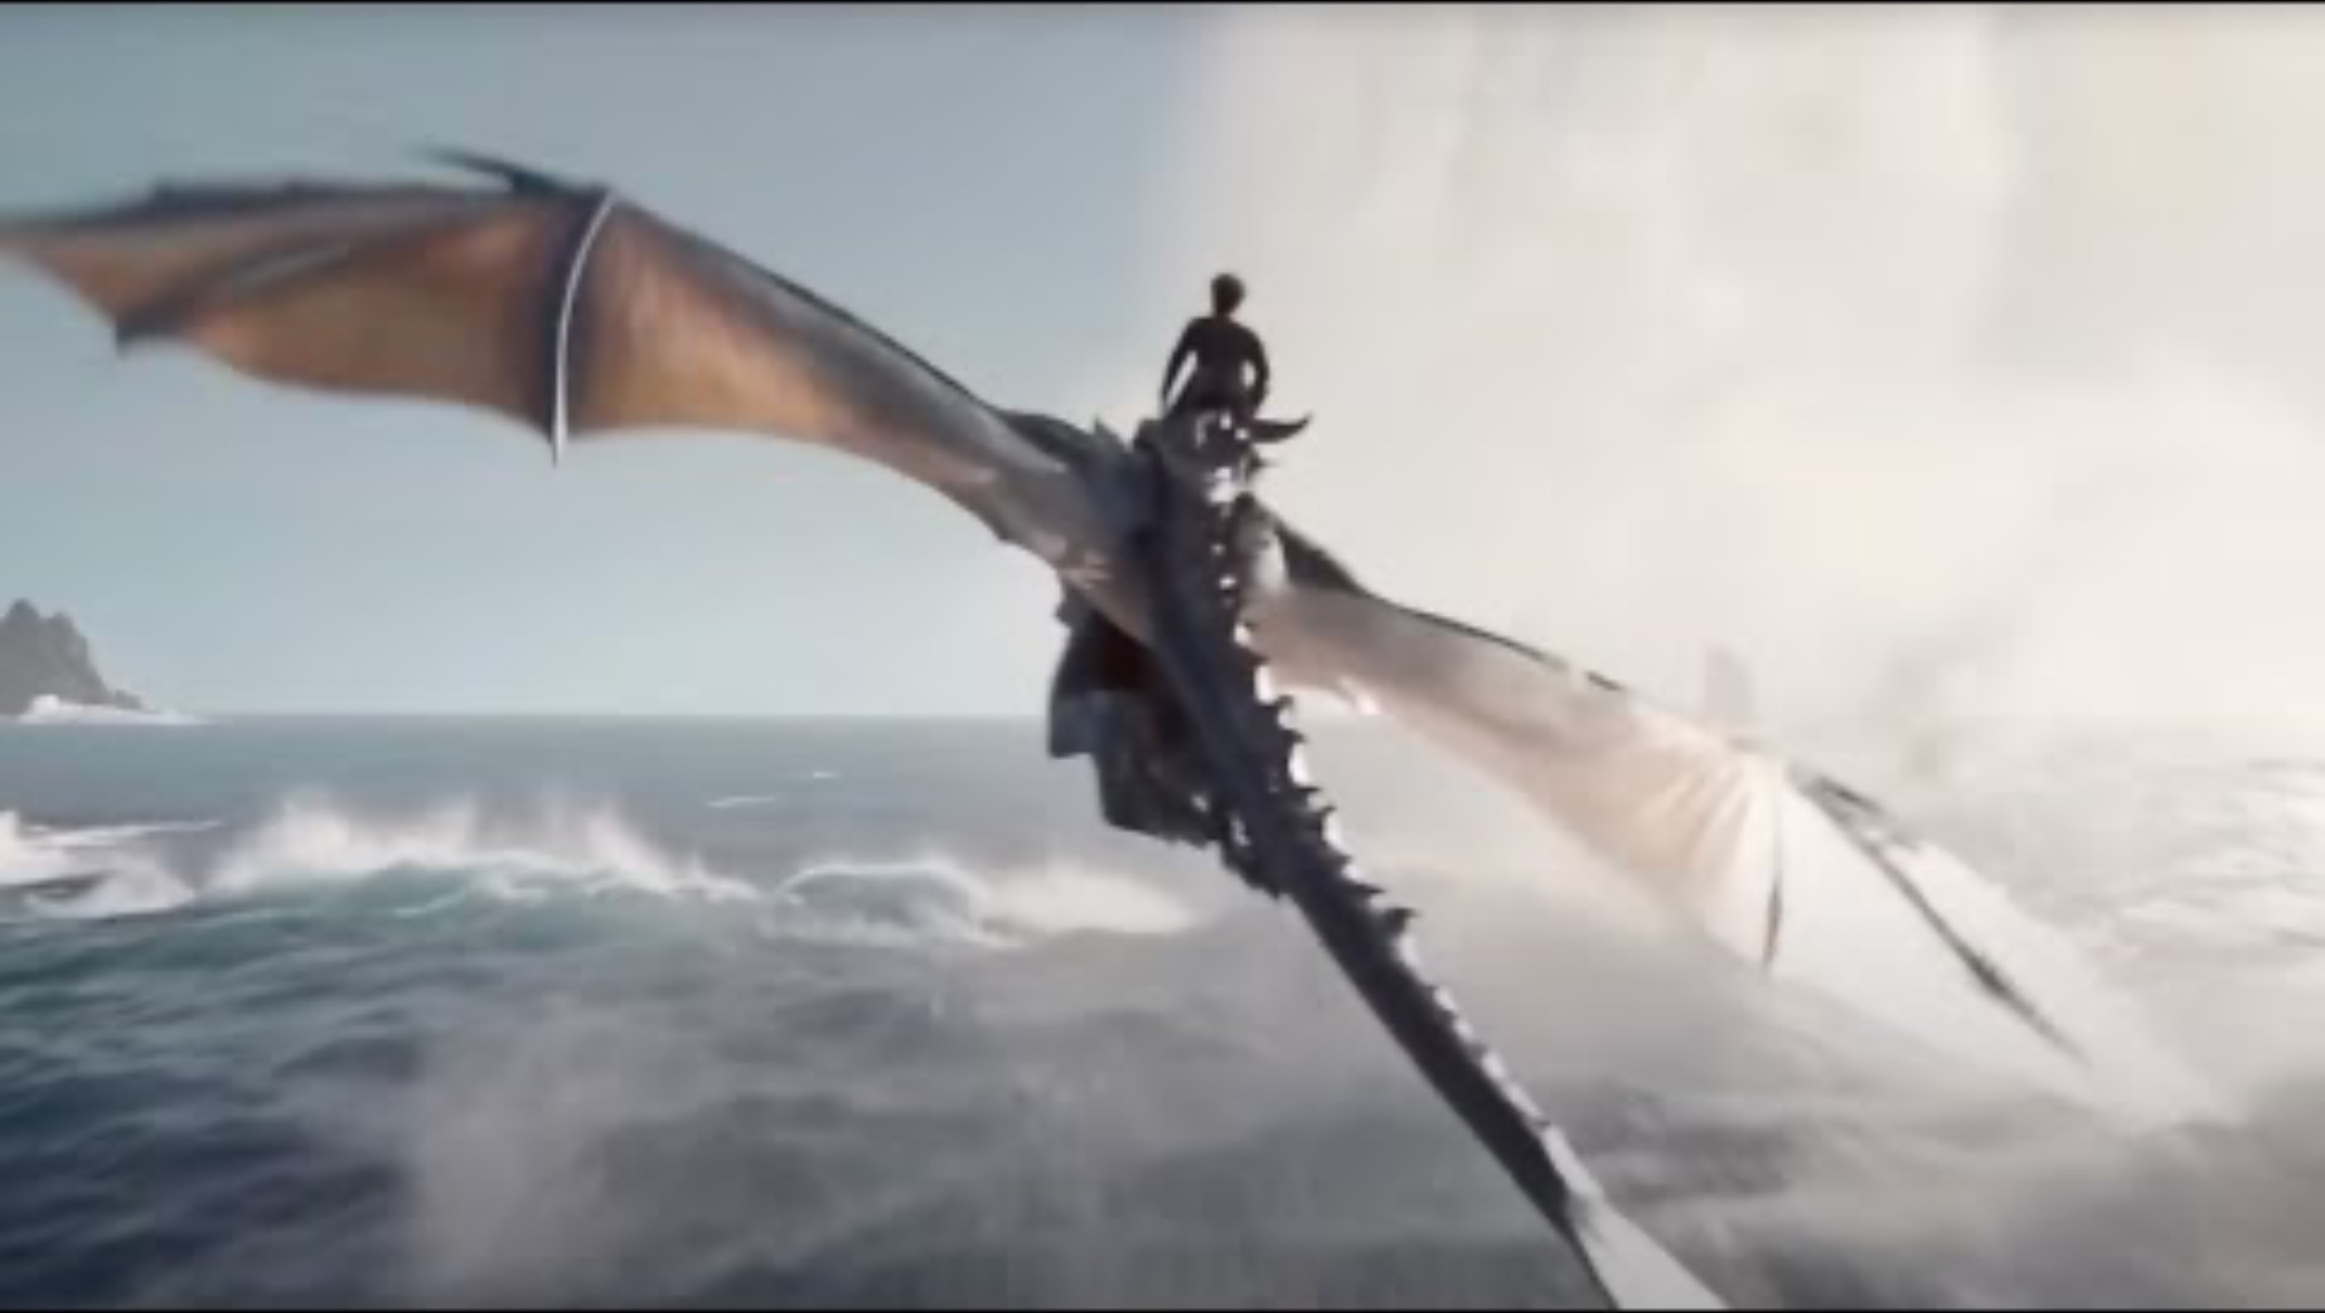

Slide 29
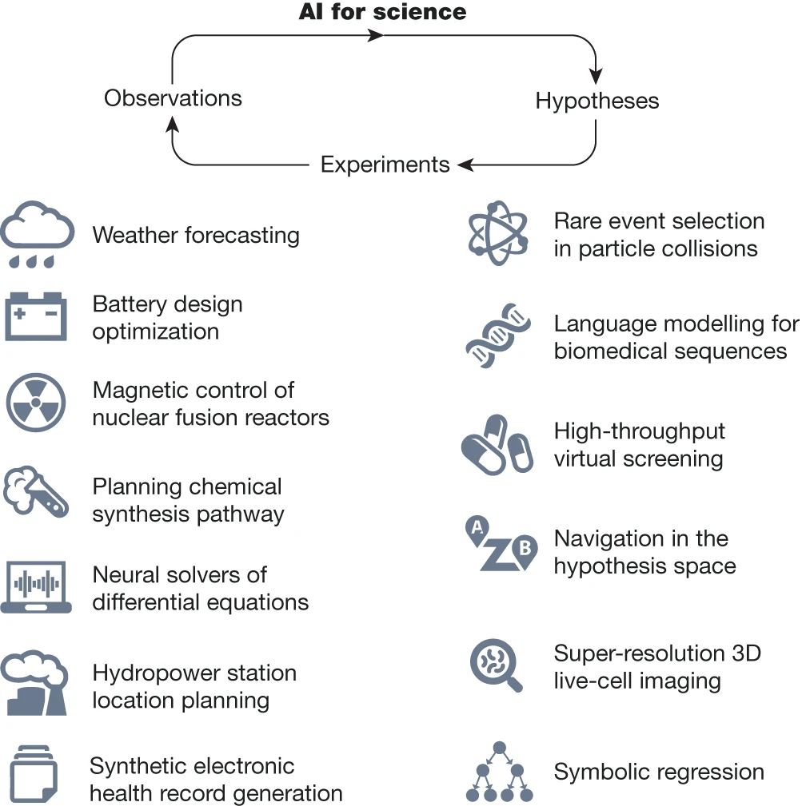
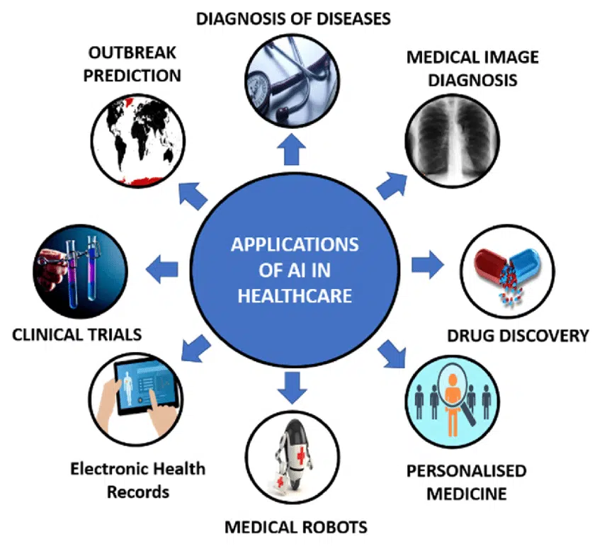
Kareem Ullah – Medium June 6th 2023
https://ai4sciencecommunity.github.io/

Slide 30
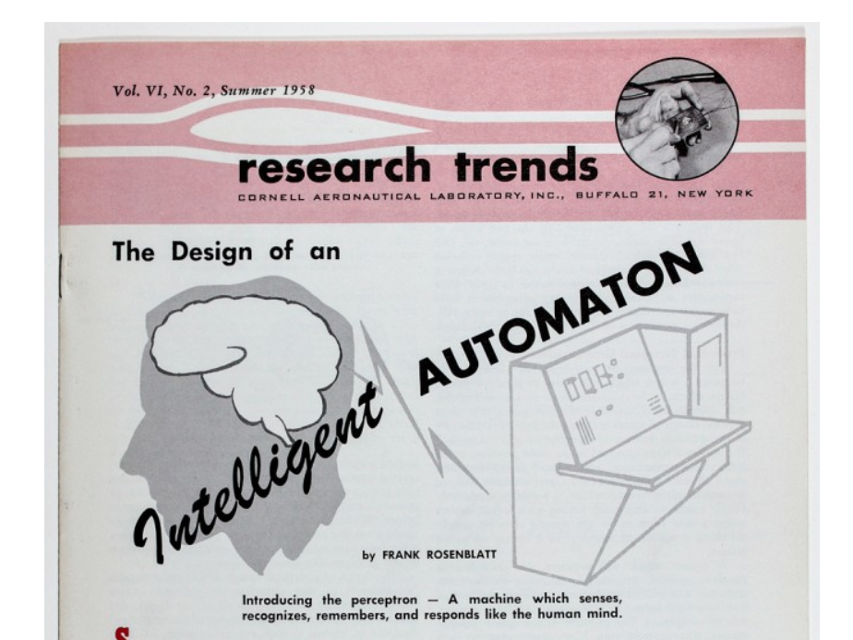
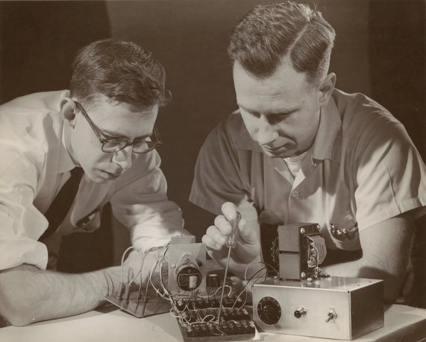
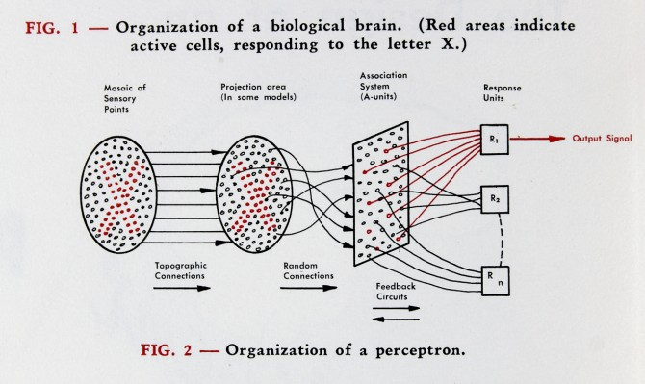
Frank Rosenblatt
Charles W. Wightman
A brief history of deep learning

Slide 31
Break

Slide 32
Frank Rosenblatt
Charles W. Wightman
A brief history of deep learning

Slide 33
Origins
Backpropagation, Rumelhart, Hinton and Williams
OCR, LeCun, Bottou, Bengio and Haffner
Alexnet, LeCun, Bottou, Bengio and Haffner
Deep Learning, Hinton, Osindero, Teh
Perceptrons, Minsky and Papert
LSTM, Hochreiter and Schmidhuber
Imagenet, Deng et al.
Perceptrons, Rosenblatt
Backpropagation, Linnainmaa
Resnet (154 layers), MSRA
Adaline, Widrow and Hoff
Backpropagation, Werbos
GO, Deepmind
1958
1960
1969
1970
1974
1986
1997
1998
2006
2009
2012
2015
today

Slide 34
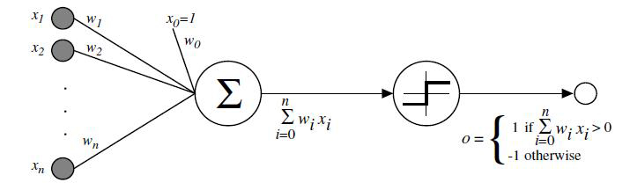
The perceptron
Single layer perceptron for binary classification.
One weight w_{i} per input x_{i}
Multiple each input with its weight, sum, and add bias
If result larger than threshold, return 1, otherwise return 0

Slide 35
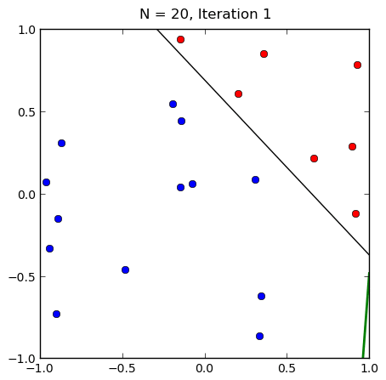
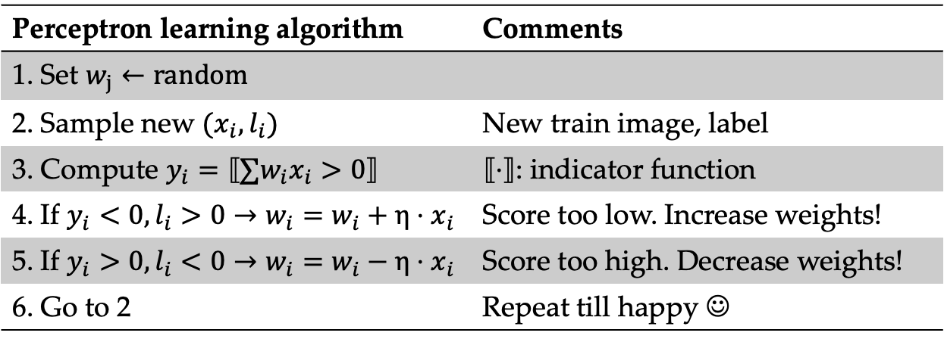
Training the perceptron
Perceptron learning algorithm | Comments
1. Set $w_{j}←random$
2. Sample new $(x_{i}, l_{i})$ | New train image, label
3. Compute $y_{i}=⟦∑w_{i}x_{i}>0⟧$ | $⟦⋅⟧$: indicator function
4. If $y_{i}<0,l_{i}>0→w_{i}=w_{i}+η⋅x_{i}$ | Score too low. Increase weights!
5. If $y_{i}>0,l_{i}<0→w_{i}=w_{i}−{η⋅x}_{i}$ | Score too high. Decrease weights!
6. Go to 2 | Repeat till happy ☺

Slide 36
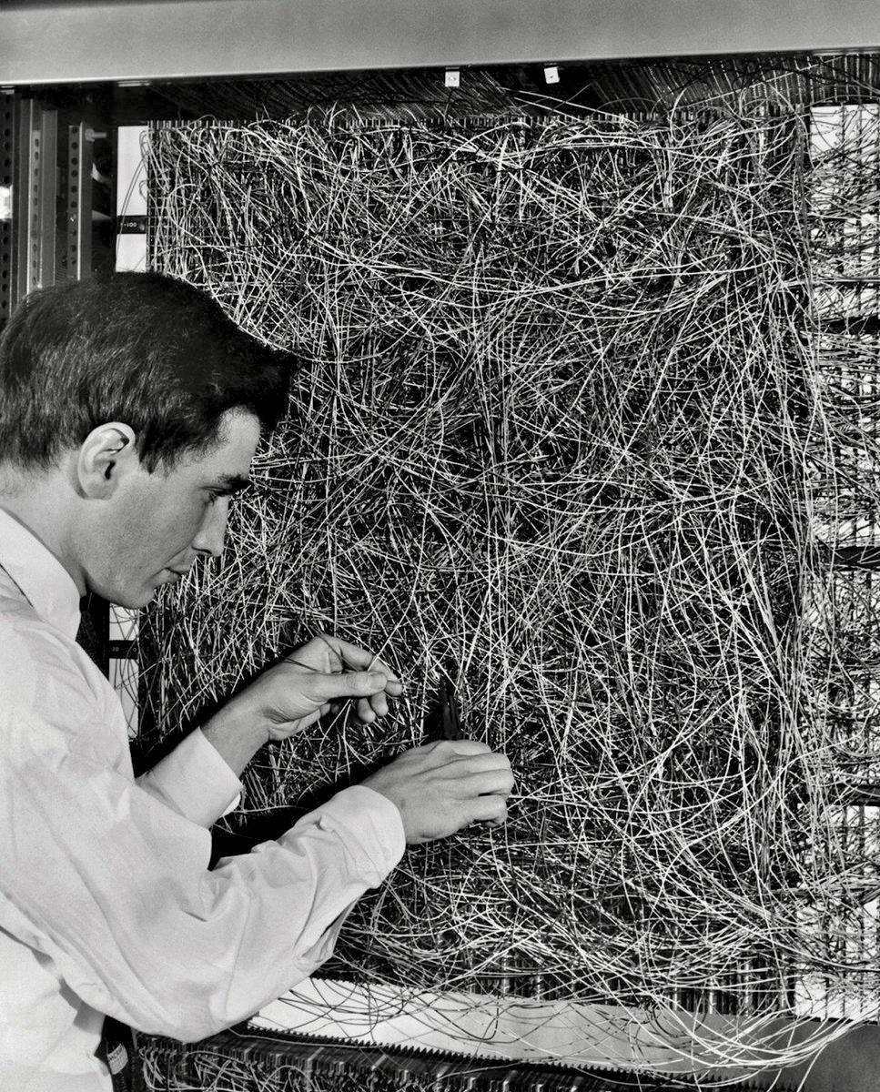
Hyping up the perceptron
“a machine which senses, recognizes, remembers, and responds like a human mind”

Slide 37
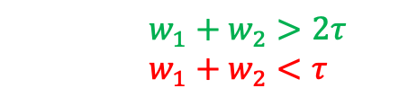
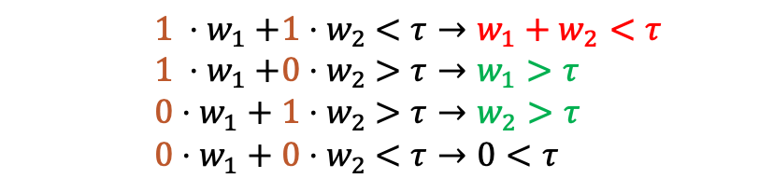
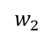
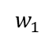
XOR: The simplest hurdle
Input 1 | Input 2 | XOR
1 | 1 | -1
1 | 0 | +1
0 | 1 | +1
0 | 0 | -1
$$1 {⋅w}_{1}+1{⋅w}_{2} <τ→{w_{1}+w}_{2}<τ$$
$$1 {⋅w}_{1}+0{⋅w}_{2} >τ→w_{1}>τ$$
$$0⋅w_{1}+1{⋅w}_{2} >τ→w_{2}>τ$$
$$0⋅w_{1}+0{⋅w}_{2} <τ→0<τ$$
$$w_{1}+w_{2}>2τ$$
$${w_{1}+w}_{2}<τ$$
Inconsistent
Output
$$w_{1}$$
$$w_{2}$$
No line can separate the white from the black
Input 1
Input 2

Slide 38
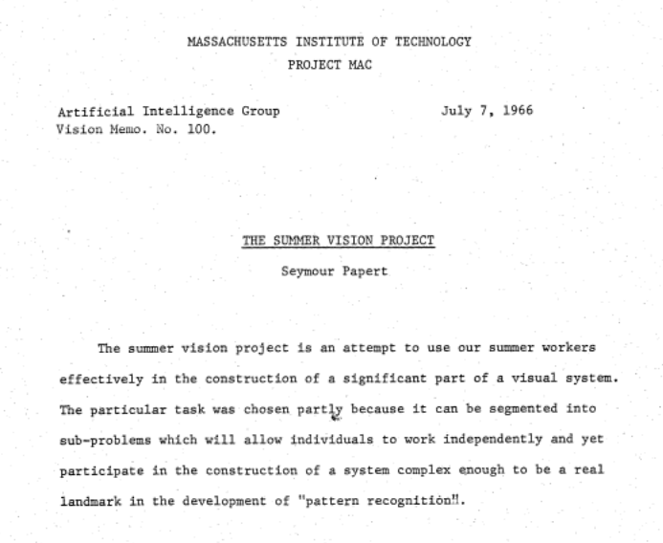
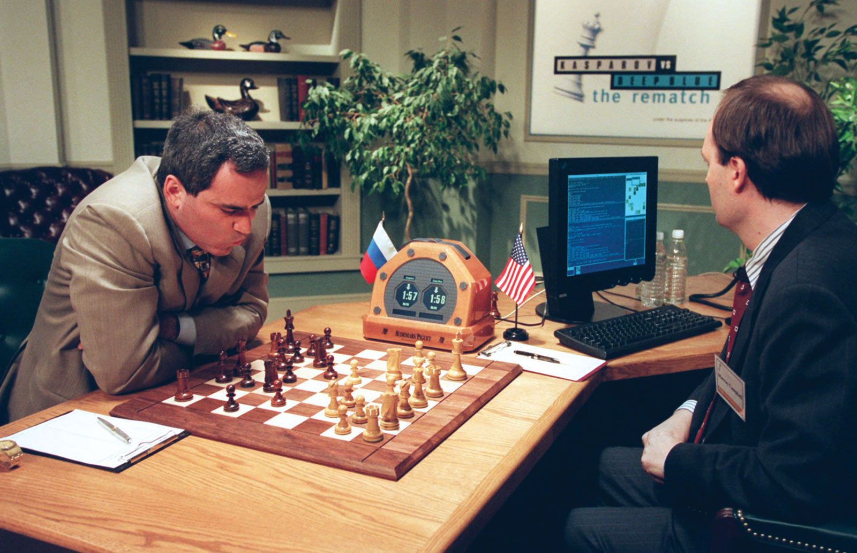
Moravec’s paradox
Reasoning requires little computation, perception from sensors a lot.

Slide 39
“AI Winter”
OCR, LeCun, Bottou, Bengio and Haffner
Deep Learning, Hinton, Osindero, Teh
LSTM, Hochreiter and Schmidhuber
Alexnet, LeCun, Bottou, Bengio and Haffner
Backpropagation, Rumelhart, Hinton and Williams
Backpropagation, Linnainmaa
Perceptrons, Minsky and Papert
Imagenet, Deng et al.
Perceptrons, Rosenblatt
Resnet (154 layers), MSRA
Adaline, Widrow and Hoff
Backpropagation, Werbos
GO, Deepmind
1958
1960
1969
1970
1974
1986
1997
1998
2006
2009
2012
2015
today

Slide 40
AI Winter
“If a perceptron cannot even solve XOR, why bother?”
Lack of funding due to overhyping.
Still, significant discoveries were made in this period
Backpropagation → Learning algorithm for MLPs by Linnainmaa
Recurrent networks → Varied-length inputs by Rumelhart
CNNs → Neocognitron by Fukushima

Slide 41
The two paths of machine learning research
Path 1:
Fix perceptrons by making better features.
Path 2:
Fix perceptrons by making them more complex.

Slide 42
Path 1: Better inputs
Philosophy: encode domain knowledge to help machine learning algorithms.
Classical image recognition pipeline:
Extract local features.
Aggregate local features over image.
Train classical models on aggregations.

Slide 43
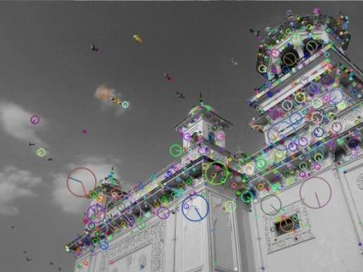
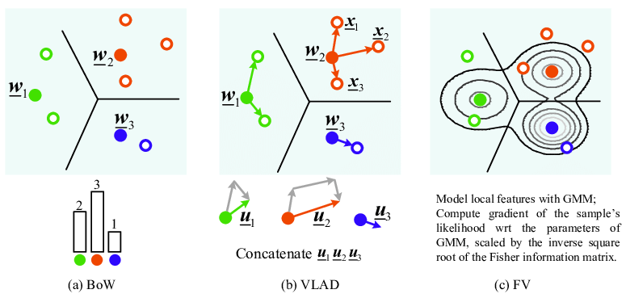
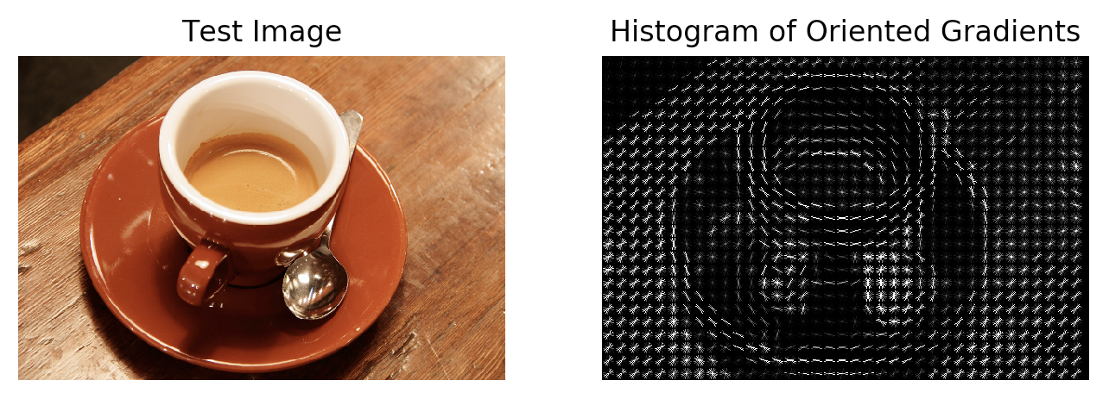
Feature engineering: image domain

Slide 44
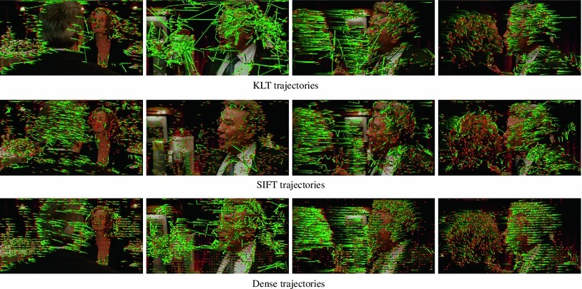
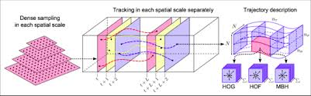
Feature engineering: video domain

Slide 45
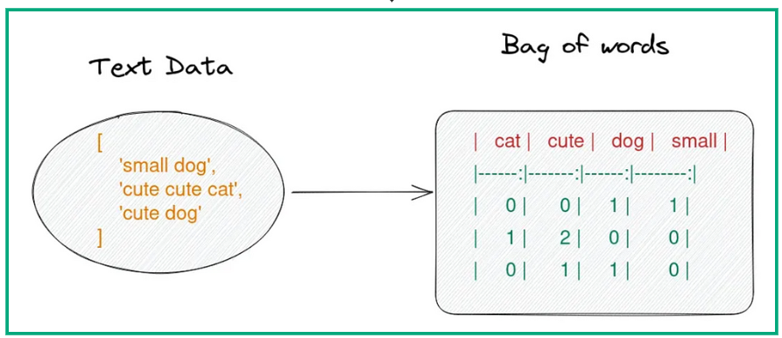
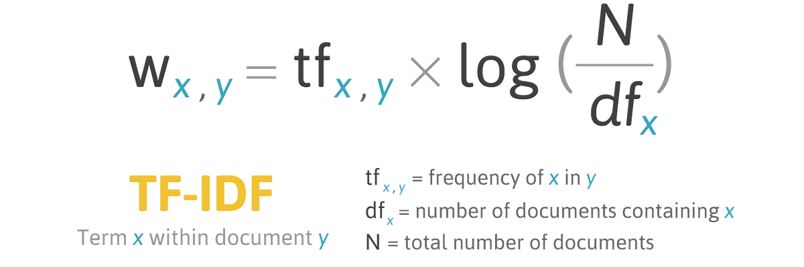
Feature engineering: text domain

Slide 46
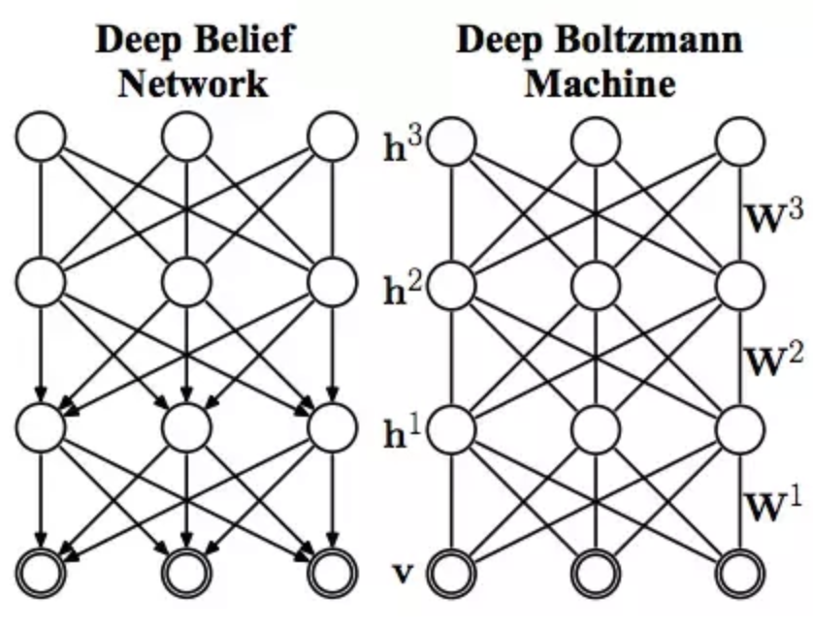
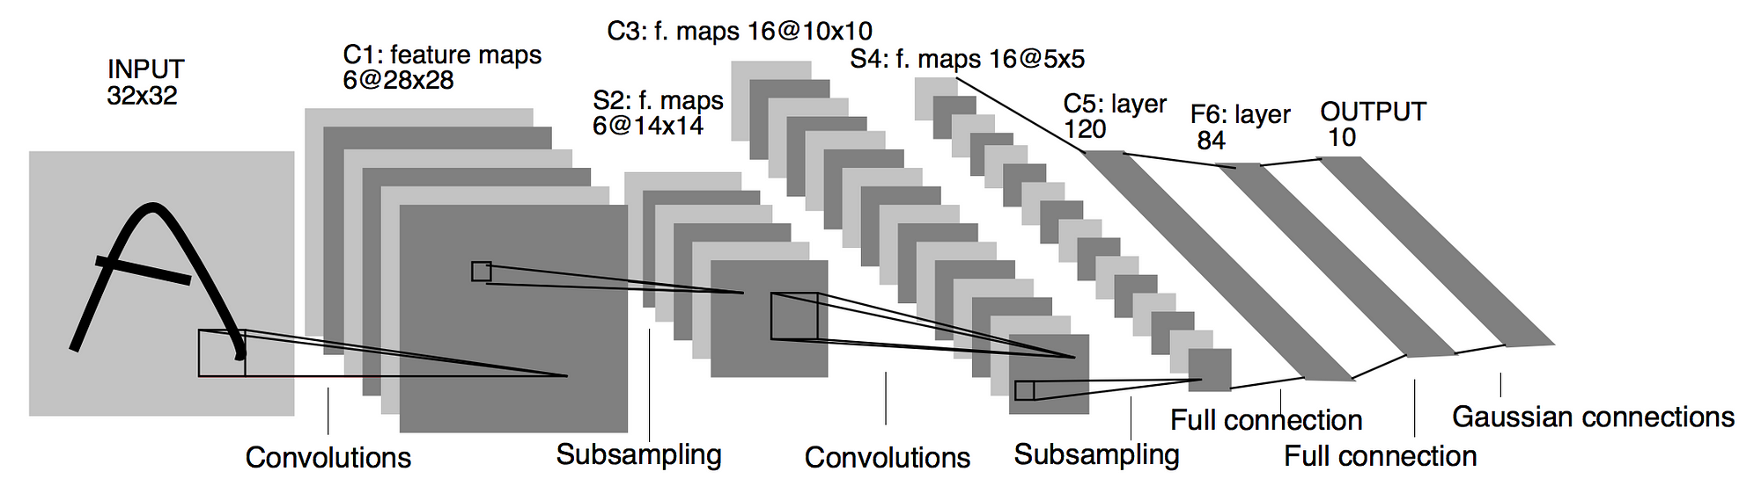
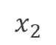
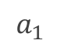






Path 2: Neural networks beyond a single layer
$$x_{1}$$
$$a_{1}$$
$$x_{2}$$
$$a_{2}$$
$$y_{1}$$
$$x_{3}$$
$$a_{3}$$
$$x_{4}$$

Slide 47
The thaw of AI Winter
Backpropagation, Rumelhart, Hinton and Williams
OCR, LeCun, Bottou, Bengio and Haffner
Alexnet, LeCun, Bottou, Bengio and Haffner
Deep Learning, Hinton, Osindero, Teh
LSTM, Hochreiter and Schmidhuber
Imagenet, Deng et al.
Perceptrons, Minsky and Papert
Resnet (154 layers), MSRA
Perceptrons, Rosenblatt
Backpropagation, Linnainmaa
Adaline, Widrow and Hoff
Backpropagation, Werbos
GO, Deepmind
1958
1960
1969
1970
1974
1986
1997
1998
2006
2009
2012
2015
today

Slide 48

Signs of life of deep neural networks…
In 2006，Hinton and Salakhutdinov found multi-layer feedforward neural networks can be pretrained layer by layer.
Fine-tuned by backpropagation
Deep Belief Nets (DBNs)
(based on Boltzmann machines)

Slide 49

Deep learning arrives
Easier to train one layer at a time $→$ Layer-by-layer training
Training multi-layered neural networks became easier
Benefits of multi-layer networks, but single-layer easy of training
Freeze layer 3
Freeze layer 2
Training layer 1
Input

Slide 50
Deep learning arrives
Easier to train one layer at a time $→$ Layer-by-layer training
Training multi-layered neural networks became easier
Benefits of multi-layer networks, but single-layer easy of training
Freeze layer 3
Freeze layer 2
Training layer 1
Input

Slide 51

Deep learning arrives
Easier to train one layer at a time $→$ Layer-by-layer training.
Training multi-layered neural networks became easier.
Benefits of multi-layer networks, but single-layer ease of training.
Freeze layer 3
Freeze layer 2
Training layer 1
Input

Slide 52
Challenges of neural networks then
Lack of processing power
Lack of data
Overfitting
Vanishing gradients
Experimentally, training multi-layer perceptrons was not that useful
“Are 1-2 hidden layers the best neural networks can do?”

Slide 53


…hence many skeptics remain

Slide 54
Deep learning arrives
Backpropagation, Rumelhart, Hinton and Williams
OCR, LeCun, Bottou, Bengio and Haffner
Alexnet, LeCun, Bottou, Bengio and Haffner
Deep Learning, Hinton, Osindero, Teh
LSTM, Hochreiter and Schmidhuber
Resnet (154 layers), MSRA
Perceptrons, Minsky and Papert
Imagenet, Deng et al.
Perceptrons, Rosenblatt
Backpropagation, Linnainmaa
Adaline, Widrow and Hoff
Backpropagation, Werbos
GO, Deepmind
1958
1960
1969
1970
1974
1986
1997
1998
2006
2009
2012
2015
today

Slide 55

Turns out that deep learning is data hungry
In 2009 the ImageNet dataset was published [Deng et al., 2009]
Collected images for all 100K terms in Wordnet (16M images in total)
Terms organized hierarchically: “Vehicle”→“Ambulance”
ImageNet Large Scale Visual Recognition Challenge (ILSVRC)
1 million images, 1,000 classes, top-5 and top-1 error measured
CNN based, non-CNN based

Slide 56

ImageNet 2012 winner: AlexNet

Slide 57

ImageNet
Most commonly used version: ImageNet-12: 1K categories, ~1.3M images, ~150GB. From Fei-Fei Li
Explore them here: https://knowyourdata-tfds.withgoogle.com/#tab=STATS&dataset=imagenet2012
(Important to also “see” the data, do not just throw a neural network at it!)
Also check out: On the genealogy of machine learning datasets: A critical history of ImageNet. Denton et al. 2021

Slide 58





Evolution of scale
Datasets of everything (video, multi-modal, robots etc. )
Imagenet: 1000 classes from real images, 1M images
Object recognition with CNN
OCR with CNN
Bank cheques
Backpropagation
Perceptron
Parity, negation problems
1. Better hardware
3. Better algorithms
Mark I Perceptron
2. Bigger data
Potentiometers

Slide 59
Golden era of deep learning
Backpropagation, Rumelhart, Hinton and Williams
OCR, LeCun, Bottou, Bengio and Haffner
Alexnet, LeCun, Bottou, Bengio and Haffner
Deep Learning, Hinton, Osindero, Teh
Resnet (154 layers), MSRA
Perceptrons, Rosenblatt
Perceptrons, Minsky and Papert
Backpropagation, Werbos
LSTM, Hochreiter and Schmidhuber
Imagenet, Deng et al.
Adaline, Widrow and Hoff
Backpropagation, Linnainmaa
DALL-Ev3, ChatGPT etc
Go, Deepmind
GPT-3, OpenAI
1958
1960
1969
1970
1974
1986
1997
1998
2006
2009
2012
2015
2017
2020
2023

Slide 60


Scale, scale, scale

Slide 61

Current scaling of models
BERT model (354M parameters) ~ now $2K
RoBERTa (1000 GPUs for a week) ~ now $350K
GPT-3 (175B parameters, 1500 GPUs for 2 months) ~ $3M
…
PaLM
6144 TPUs, ~$25M
3.2 million kWh ~~1000 Households for a year
Source:
https://twitter.com/tomgoldsteincs/status/1544370726119112704

Slide 62

Is deep learning ready for the real world?

Slide 63




Deadly accidents
Misinformation
Surveillance concerns
Bias

Slide 64
Deep learning: an ongoing effort
Rapid advances and quick strides.
AI is already assisting us with many basic efforts.
Many fundamental issues remain:
Causality, generalization, robustness, hierarchies, facts/knowledge, continuality, alignment, sustainability, …

Slide 65


Is AI only deep learning?

Slide 66
Recap
Course overview
History of deep learning
Future of deep learning

Slide 67
Learning and reflection
Understanding Deep Learning: Chapter 1
Annotated History of Modern AI and Deep Learning – Jürgen Schmidhuber
All reading is in ”Reading Materials” under “Modules” in Canvas

Slide 68
Next lecture
Lecture | Title
1 | Intro and history of deep learning
3 | Deep learning optimization I
5 | Convolutional deep learning
7 | Graph deep learning
9 | Multi-modal deep learning
11 | What doesn’t work in deep learning
13 | Q&A
Lecture | Title
2 | AutoDiff
4 | Deep learning optimization II
6 | Attention-based deep learning
8 | From supervised to unsupervised deep learning
10 | Generative deep learning
12 | Non-Euclidean deep learning
14 | Deep learning for videos

